Slide 1




Device simulation at scale using Docker Swarm
Docker birthday : 2019
30th March 2019
Hemant Gaikwad, Test Architect
h_gaikwad@dell.com

Slide 2


Why Z10N
Imagine a world where you can…
Cut through the massive costs/efforts Reduce hardware dependency
Drastically simplify validation of complex sensor states/error conditions
Seamlessly execute automation for every build without worrying about the infrastructure availability

Slide 3






What is Z10N
The best advice to those about to embark on a very large simulation is
often the same as Punch’s famous advice to those about to marry: Don’t !
– Bratley, Fox and Schrage (1986)
ZION started off as a stretch assignment for supporting device simulation
It creates real world lab environment with thousands of devices at the fraction of cost for physical devices
Rapid recording of required devices over multiple protocols
Easy deployment of recorded device simulation across thousands of nodes
Supports device communication over multiple interfaces like Redfish, WSMAN, WMI, SNMP, SSH, etc

Slide 4

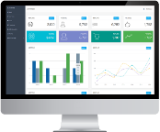
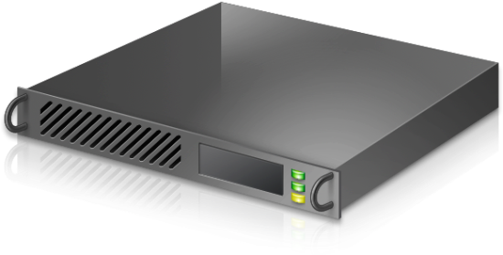










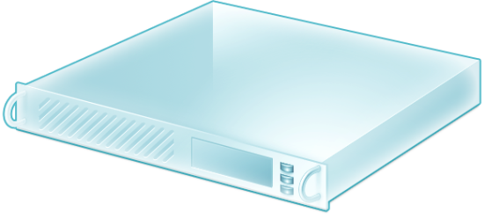

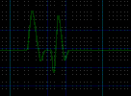

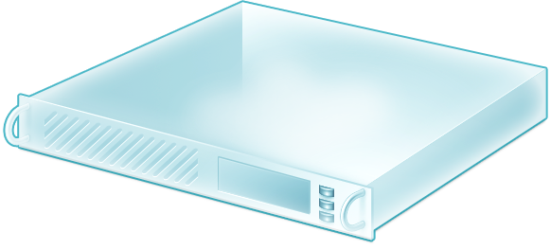
Deployment
Compete !!
Recording complete !!
Recording
Physical device
Management Station/Client
Recording request
Deployment request
User
Database
Marketplace
Deployment
Docker Cluster
Lease management

Slide 5
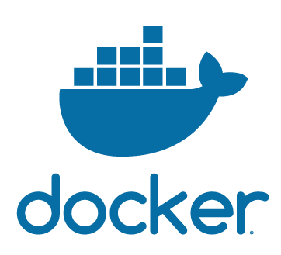
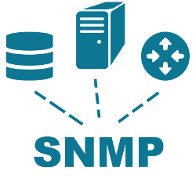


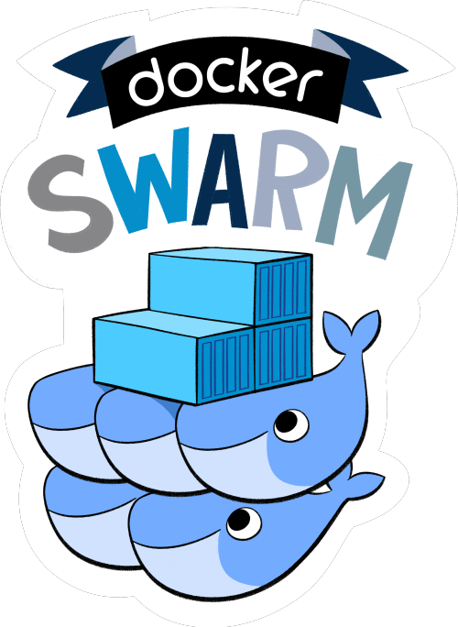









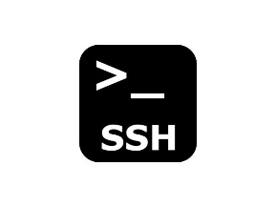



Slide 6
Simulation requirement
1
2
3
4
Each simulated node to be hosted as a unique public IP Address endpoint
Multi-user concurrent device recording and deployment
Rapid provisioning/destruction of the device simulations at scale
Quick customization of device configuration/health across thousands of simulated nodes
5
6
7
8
Quick alert storm generation from multiple nodes with varying rate
Maximum use of Open Source components wherever applicable
Leverage common storage for accessing code, scripts and data
High Availability

Slide 7
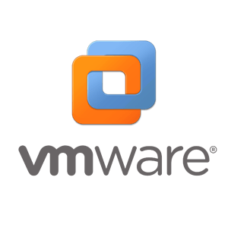

Trial and Errors
2017 VM solution + OpenVZ drop + Docker Trial
VMware based hypervisor solution with Windows & CentOS VMs
Trials with OpenVZ containers halted after stability issues
Trials with Docker swarm with macvlan with base OS as CentOS, Ubuntu & Fedora. Trial positive. Docker Swarm deployed
2014-2015 VM solution
VMware based hypervisor solution with Windows VMs
2019 Docker prevails
Docker Swarm supporting 32K simulations across 11 servers
2016 VM solution + OpenVZ Trial
VMware based hypervisor solution with Windows & CentOS VMs
Trials with OpenVZ containers with unique public IP Address per container and external storage.
2018 VM solution + Docker solution
VMware based hypervisor solution with Windows & CentOS VMs ramp down with eventual drop
Docker Swarm fully operational

Slide 8


Setup Summary
11 x DellEMC PowerEdge R930
4 x CPUs
Intel(R) Xeon(R) CPU E7-4809 v3 @ 2.00GHz with 8 cores
16 x 32 GB DDR-4 RAM
4 x BCM57840 NetXtreme II 10 Gigabit Ethernet NICs
Fedora 28
Docker 18.06.0-ce
2 TB Docker partition
Docker Swarm
5 managers & 6 workers
~4000 containers per node
32K simulated nodes with public IP Address

Slide 9
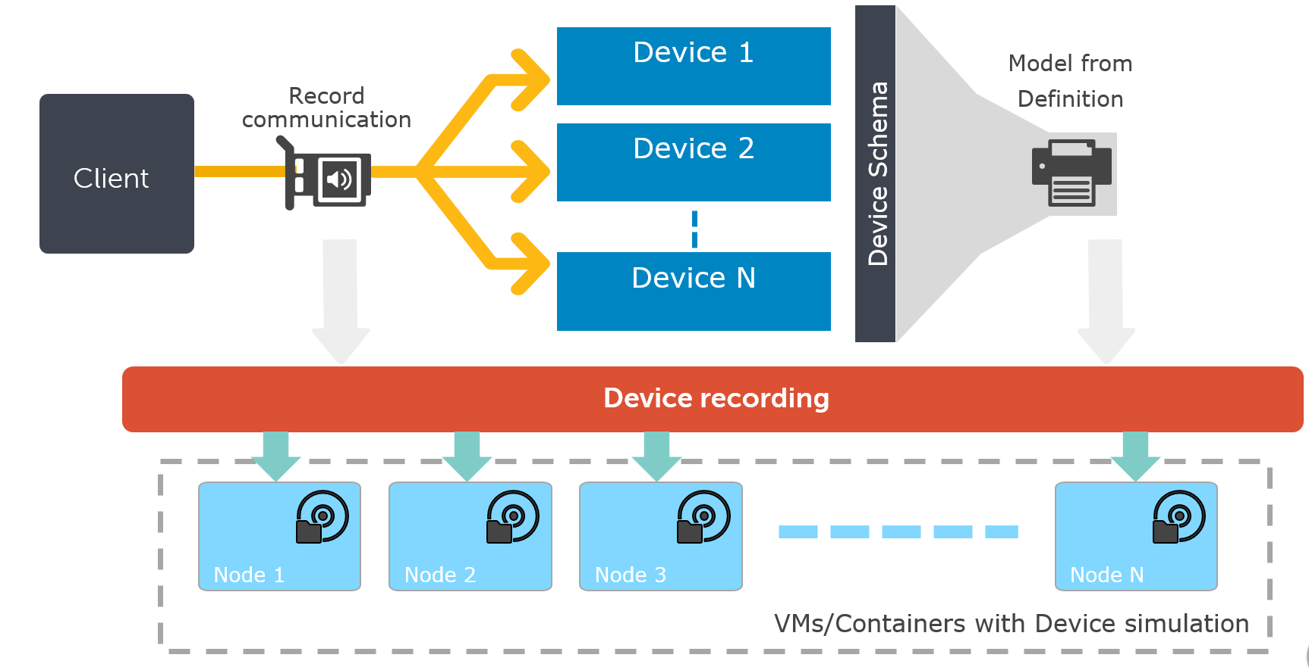
Containerization strategy
Server
Separate 2TB VD created per server to host Docker files
4 NICs team together
Host
Fedora 28 installed on all 11 servers
2TB VD mounted as /data
Docker
Docker 18.06.0-ce installed on all 11 servers
Docker config tweaked to start Docker on mount /data with ExecStart=/usr/bin/dockerd -g /data/
Docker config tweaked to set TasksMax=infinity
Docker swarm initiated with 5 managers & 6 workers
Docker macvlan network created to host containers in public network with 32K public IP addresses

Slide 10
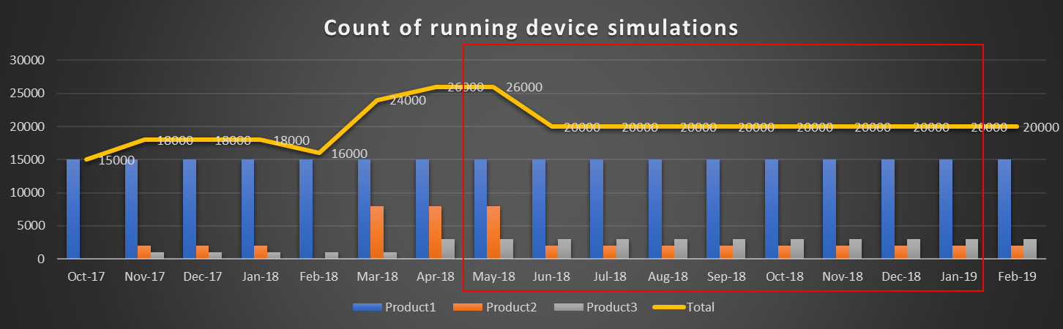
Docker Value
15K simulation containers running non-stop for 9 months without any issues at all
Stable across scaled bring-up & tear-down and super Responsive with each simulation queried for hundreds of SNMP, SOAP or REST calls at a regular frequency

Slide 11
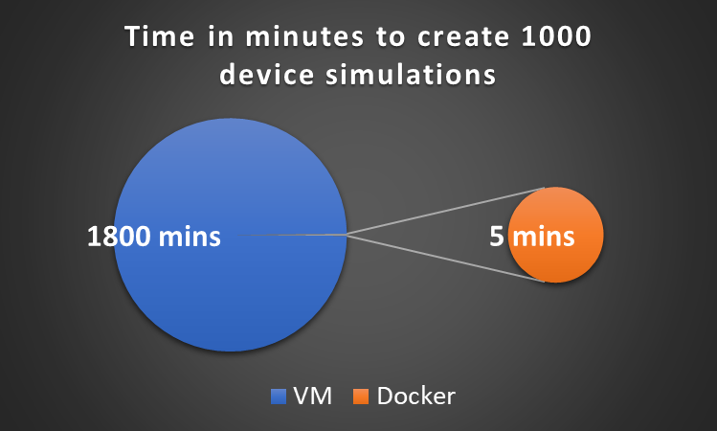
Docker Value : Time
Creation time of 1000 device simulations is 360X lesser with Docker

Slide 12
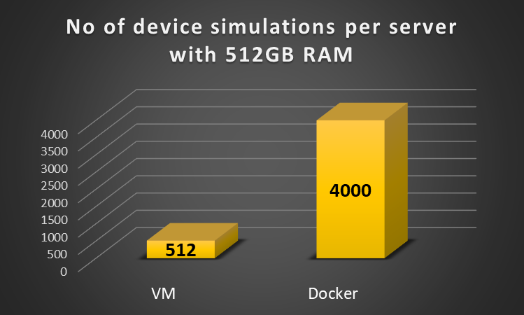
Docker Value : Cost
7X more device simulations per server
4000 (not the max count)
It was just a conservative number considering decent load balancing

Slide 13

Docker Advantage
Simple
Scalable
Unified
Future-proof
Flexible
Simple dashboard with abstraction of background details
Turn-key recording & deployment
North bound API
Dynamic state, event & task machine
Policy driven leasing
Single click rapid deployment on thousands of nodes
Scale with Docker containers
Fault tolerant scalable infra
All-in-one protocol support
Multi-user
Recording, deployment & provisioning from single dashboard
Huge Capex saving
Perpetual availability
Write operation ready for update simulation
Deterministic behavior & performance
Auto-learn and adapt mode
On-the-fly randomization
Device/Protocol agnostic
Open to all, schema driven
Build once use often with Z10N Marketplace
Z10N Values highlighted in Blue are influenced by the use of Docker

Slide 14
Business Value
Reduction in expenditure by more than 99% with total cost saving estimated above $ 1M
5X reduction in hardware due to protocol consolidation
Flexibility of running functional, non-functional tests at will
Early to Market with quick & reliable Dev-Test using simulation
Reduction in expenditure by more than 99% with total cost saving estimated above $1M
Test every hardware state with single click customization
Zero touch automated execution/demos
Recurrent setup creation cost reduced to almost Zero

Slide 15

Thank you
zion@dell.com

